Slide 1
Bank Loan Case Study
By: Mohak Bidaye

Slide 2
Project Description
This project focuses on analyzing customer loan data to uncover key factors contributing to loan defaults. By leveraging Exploratory Data Analysis (EDA), the aim is to identify patterns and insights that can enhance the company's decision-making process for loan approvals. The objective is to minimize the risk of defaults while ensuring qualified applicants are not unfairly rejected, ultimately balancing business growth and financial stability.
When a customer applies for a loan, the company encounters two significant risks:
Missed Opportunity: If a creditworthy applicant is denied, the company loses potential business.
Financial Loss: If a non-creditworthy applicant is approved, the company incurs a loss.
The loan application process leads to one of four outcomes:
Approved: The loan application is approved by the company.
Cancelled: The customer withdraws their application during the approval process.
Refused: The company rejects the loan application.
Unused Offer: The loan is approved, but the customer does not utilize it.
By analyzing the loan data, this project aims to uncover actionable insights, reduce risk, and optimize the approval process to benefit both the company and its customers.

Slide 3
Approach
Importing and understanding the data set provided.
Cleaning data and identifying missing values and dealing with them appropriately.
Performing analysis and showing insights.
Visualizing the analysis and insights through graphs and charts.
Concluding the project with actionable insights which can benefit the bank.

Slide 4
Links
Excel sheet link:
https://docs.google.com/spreadsheets/d/1alUTJ4Fvwyg6QX5IRclD5pf1rqaKtf3L/edit?usp=drive_link&ouid=109524556463170667809&rtpof=true&sd=true
Google drive link to download the excel sheet if above link does not work.
The excel sheet is saved under the name ‘Project6(BankLoanProject).’
https://drive.google.com/drive/folders/1hVUPMva915K5R8FuzBxPfIppPWzz6L0a?usp=sharing

Slide 5
Tech Stack Used
Microsoft Excel 2019
Microsoft PowerPoint 2019

Slide 6
Task A: Identify the missing data in the dataset and decide on an appropriate method to deal with it using Excel built-in functions and features.
Utilized COUNTA() to determine the number of records for each column.
Calculated the percentage of missing values for every column to assess the extent of null values.
Formulas used:
To find number of records: =COUNTA(B4:B50002)
To calculate the percentage of missing values: =1-B2/$B$2
Columns with 50% or more missing values (highlighted in red) were removed from the dataset.
Additional columns that were irrelevant to the analysis (highlighted in yellow) were also deleted.

Slide 7
Deleted columns with more than 50% missing values
Deleted columns that were irrelevant to the analysis
OWN_CAR_AGE EXT_SOURCE_1 APARTMENTS_AVG BASEMENTAREA_AVG YEARS_BUILD_AVG COMMONAREA_AVG ELEVATORS_AVG ENTRANCES_AVG FLOORSMAX_AVG FLOORSMIN_AVG LANDAREA_AVG LIVINGAPARTMENTS_AVG LIVINGAREA_AVG NONLIVINGAPARTMENTS_AVG NONLIVINGAREA_AVG APARTMENTS_MODE BASEMENTAREA_MODE YEARS_BUILD_MODE COMMONAREA_MODE ELEVATORS_MODE ENTRANCES_MODE FLOORSMAX_MODE FLOORSMIN_MODE LANDAREA_MODE LIVINGAPARTMENTS_MODE LIVINGAREA_MODE NONLIVINGAPARTMENTS_MODE NONLIVINGAREA_MODE APARTMENTS_MEDI BASEMENTAREA_MEDI YEARS_BUILD_MEDI COMMONAREA_MEDI ELEVATORS_MEDI ENTRANCES_MEDI FLOORSMAX_MEDI FLOORSMIN_MEDI LANDAREA_MEDI LIVINGAPARTMENTS_MEDI LIVINGAREA_MEDI NONLIVINGAPARTMENTS_MEDI NONLIVINGAREA_MEDI
FLAG_MOBIL FLAG_EMP_PHONE FLAG_WORK_PHONE FLAG_CONT_MOBILE FLAG_PHONE FLAG_EMAIL CNT_FAM_MEMBERS REGION_RATING_CLIENT REGION_RATING_CLIENT_W_CITY EXT_SOURCE_2 EXT_SOURCE_3 YEARS_BEGINEXPLUATATION_AVG YEARS_BEGINEXPLUATATION_MODE YEARS_BEGINEXPLUATATION_MEDI TOTALAREA_MODE EMERGENCYSTATE_MODE DAYS_LAST_PHONE_CHANGE FLAG_DOCUMENT_2 FLAG_DOCUMENT_3 FLAG_DOCUMENT_4 FLAG_DOCUMENT_5 FLAG_DOCUMENT_6 FLAG_DOCUMENT_7 FLAG_DOCUMENT_8 FLAG_DOCUMENT_9 FLAG_DOCUMENT_10 FLAG_DOCUMENT_11 FLAG_DOCUMENT_12 FLAG_DOCUMENT_13 FLAG_DOCUMENT_14 FLAG_DOCUMENT_15 FLAG_DOCUMENT_16 FLAG_DOCUMENT_17 FLAG_DOCUMENT_18 FLAG_DOCUMENT_19 FLAG_DOCUMENT_20 FLAG_DOCUMENT_21

Slide 8
Percentage of null values representation:

Slide 9
Data imputation was done on the missing values.
Numerical Variables: Missing values were filled using the mean or median, depending on the distribution.
Categorical Variables: Missing values were imputed using the mode.

Slide 10
The columns DAYS_BIRTH and DAYS_EMPLOYED were changed to Age and Year_Employed using ROUND() and ABS()
Formulas used:
=ROUND(ABS(R9/365),0)
=ROUND(ABS(T9/365),0)
DAYS_BIRTH | Age | DAYS_EMPLOYED | Years_Employed
-18255 | 50 | -386 | 1
-21914 | 60 | 365243 | 1001
-15566 | 43 | -128 | 0
-12298 | 34 | -3015 | 8
-22285 | 61 | 365243 | 1001
-11290 | 31 | -1016 | 3
-12687 | 35 | -1557 | 4
-10249 | 28 | -1600 | 4
-13918 | 38 | -2542 | 7
-18670 | 51 | -1581 | 4
-11775 | 32 | -482 | 1

Slide 11
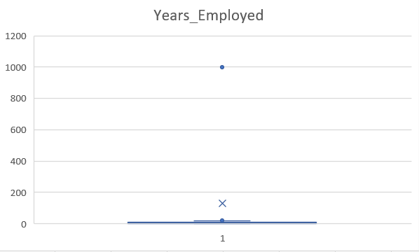
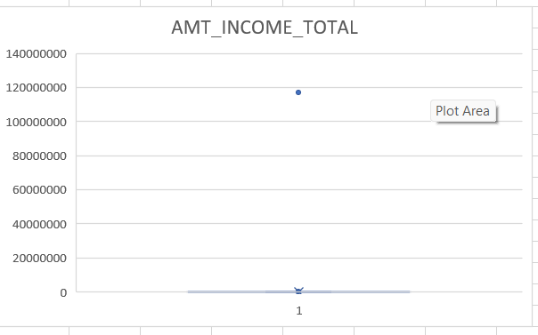
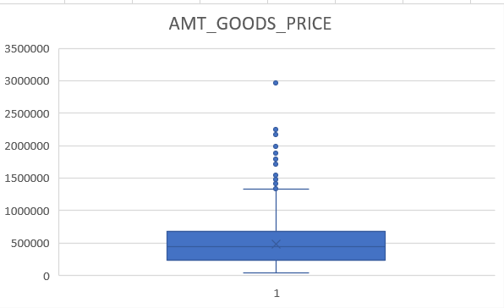
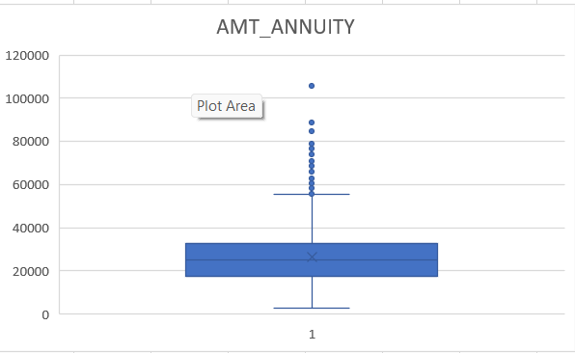
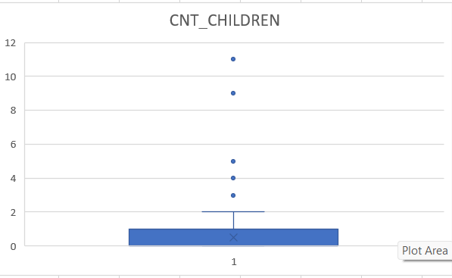
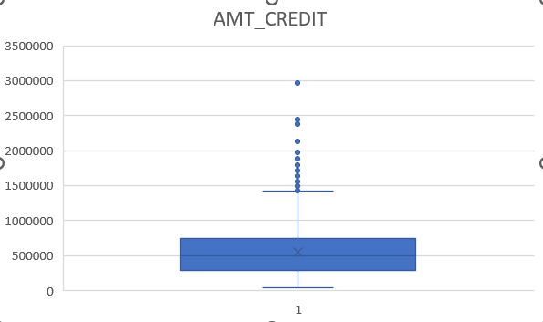
Task B: Detect and identify outliers in the dataset using Excel statistical functions and features, focusing on numerical variables

Slide 12
Outlier insights
AMT_INCOME_TOTAL is a column where one of the outlier is 117000000 which is an extremely high salary to earn.
Years_Employed has an outlier where it’s showing that there are people being employed for 1001 years and that’s not possible.
We also find outliers in CNT_CHILDREN where there is a count of 8+ children.
We find a large number of outliers in AMT_GOODS_PRICE, AMT_APPLICATION, AMT_CREDIT AND AMT_ANNUITY.

Slide 13
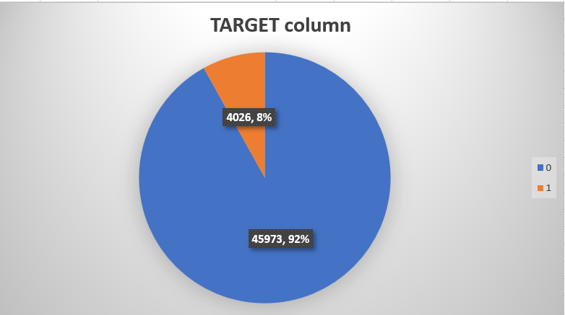
Task C: Determine if there is data imbalance in the loan application dataset and calculate the ratio of data imbalance using Excel functions.
Here we can see that 92%(blue i.e. 0) clients are loan re-payers and 8%(orange i.e. 1) are defaulters
This shows that there is an imbalance in the dataset.

Slide 14
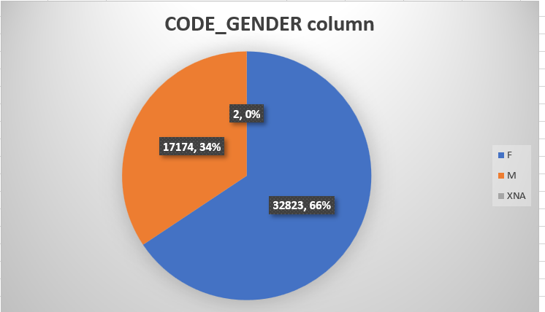
Here we see that there is an imbalance in the CODE_GENDER column where 66% of the clients are females and 34% are males.

Slide 15
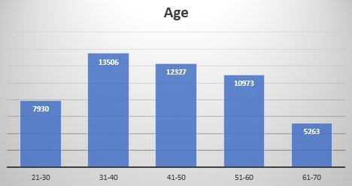
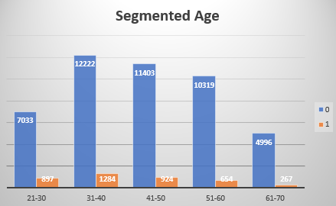
Task D: Perform univariate analysis to understand the distribution of individual variables, segmented univariate analysis to compare variable distributions for different scenarios, and bivariate analysis to explore relationships between variables and the target variable using Excel functions and features.
Univariate Analysis
We can see that, as age increases the chances of defaulter decreases
Most of the clients are in the age group of 31-40.

Slide 16
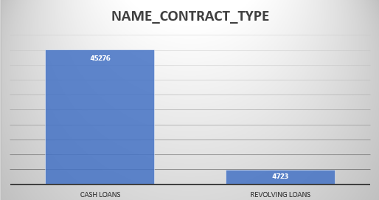
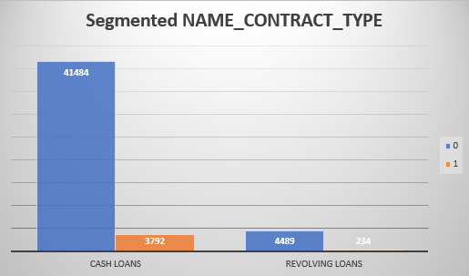
The number of cash loans is larger than the number of revolving loans

Slide 17
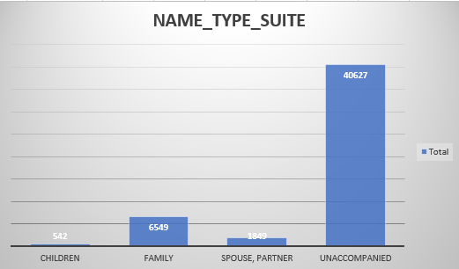
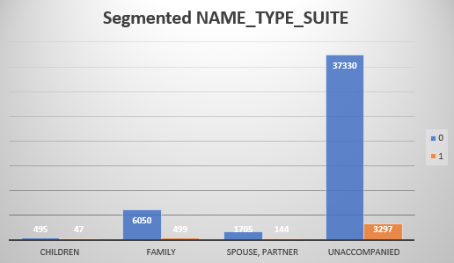
Most of the clients were Unaccompanied while taking loans, this was followed by the Family

Slide 18
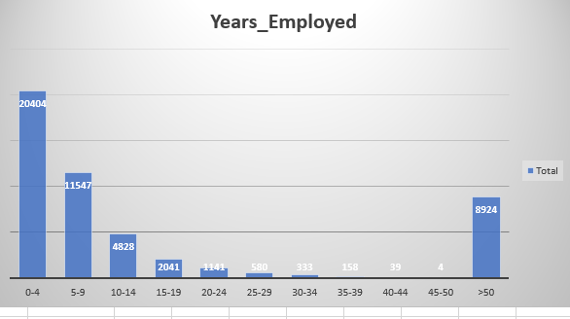
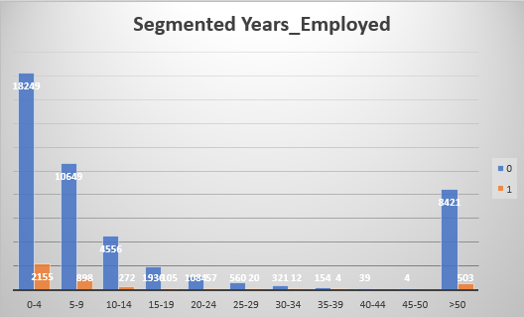
Most of the clients have 0-9 years of experience.
As experience increases, the chances of defaulting decreases.

Slide 19
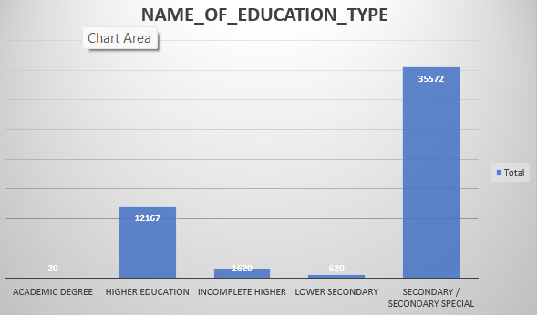
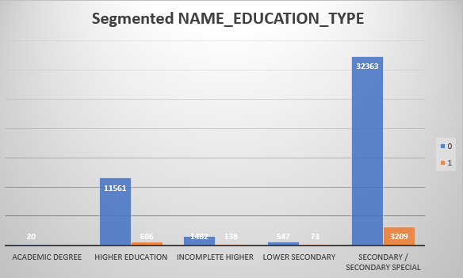
Clients with Secondary Special education have taken the highest number of loans.
Highest default: Secondary Special
Lowest default: Academic Degree

Slide 20
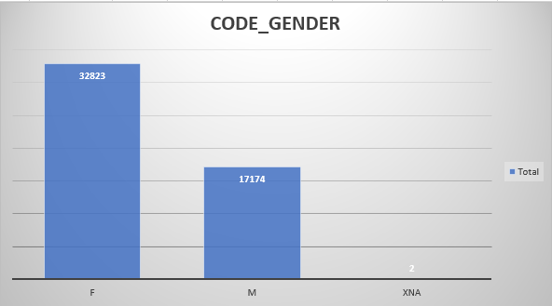
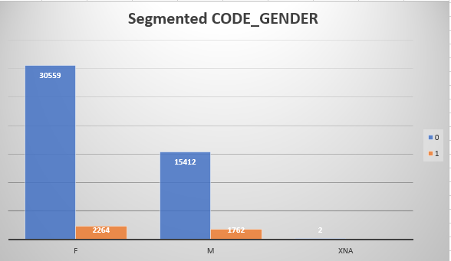
There are less male defaulters in comparison to female defaulters
Females have more defaulters but their ratio of defaulters and non-defaulters are better than males

Slide 21
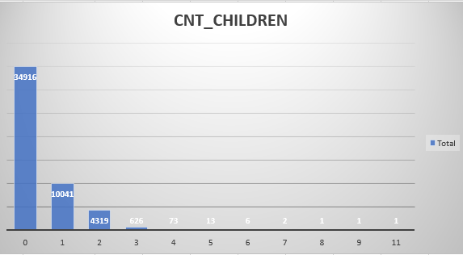
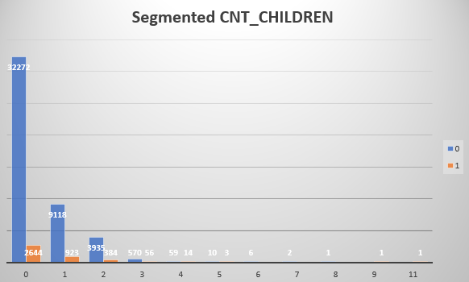
The clients without a child have taken the highest number of loans
With the increase in number of children, the number of clients who take loans decreases

Slide 22
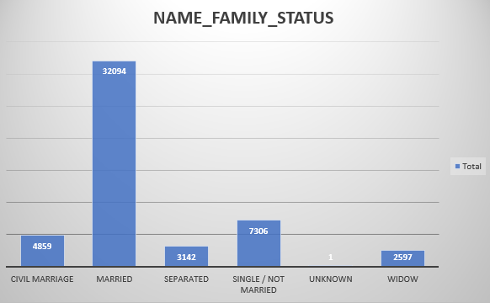
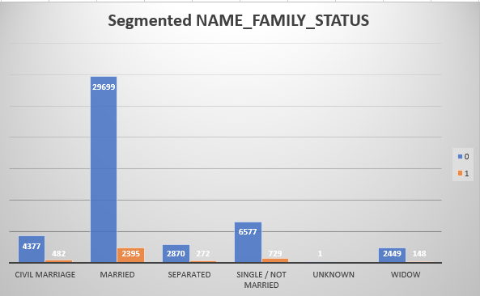
Widows are the least defaulters while Married clients are the highest defaulters.
Married clients have taken the highest number of loans whereas clients who are widows have taken the least after ignoring unknown.

Slide 23
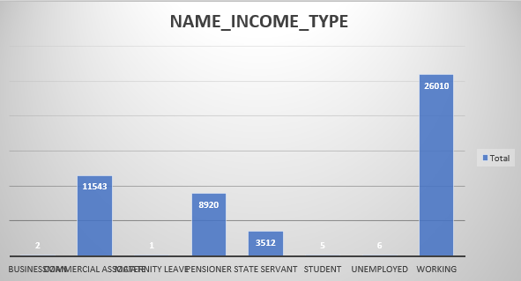
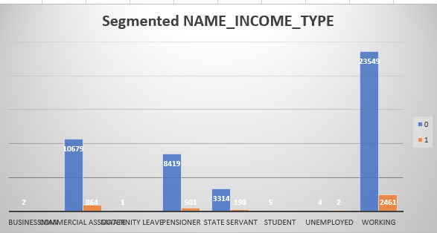
The groups whose income type is working are targeted by banks.
Clients that are businessman or students or at maternity leave are least defaulters.
Clients that are working are highest defaulters.

Slide 24
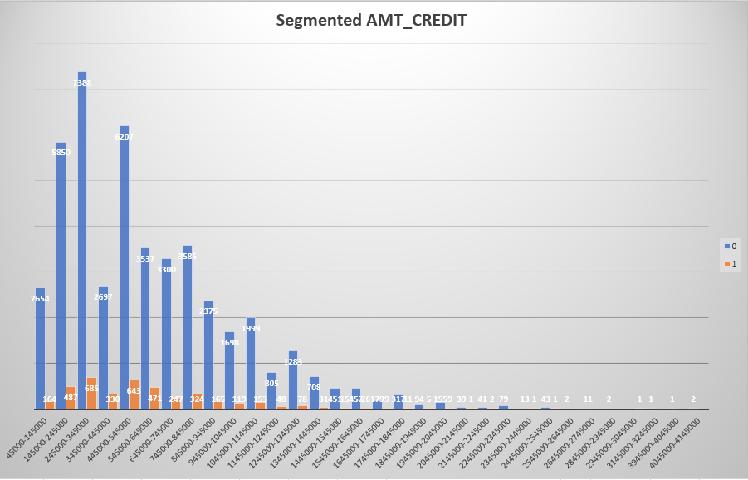
Majority of the clients took the loan between 2L – 3L.

Slide 25
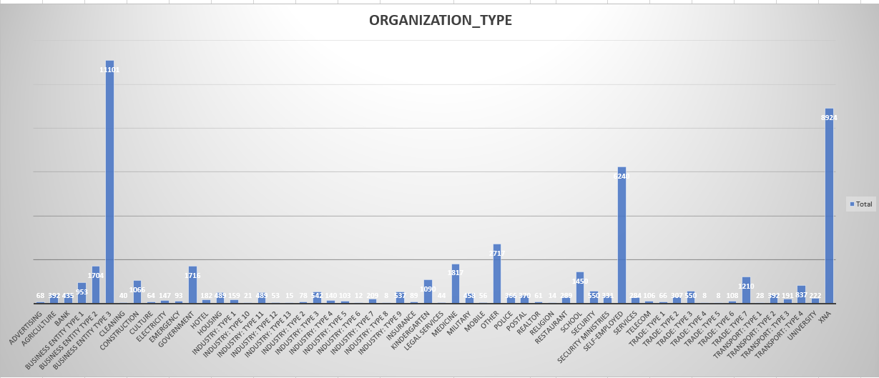
We can see that the clients working in Business Entity Type of organization took the highest number of loans

Slide 26
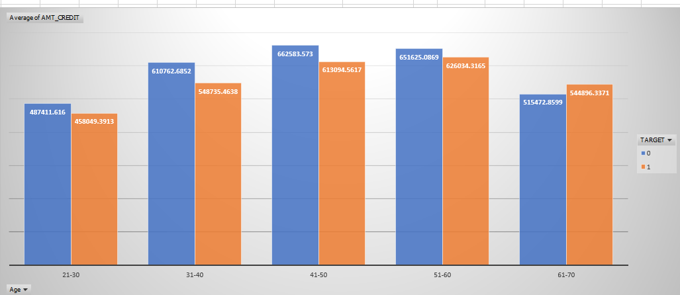
Bivariate Analysis
Age group 50-60 are the defaulter with the highest amount of loan. The age group 41-50 took the highest amount of loans

Slide 27
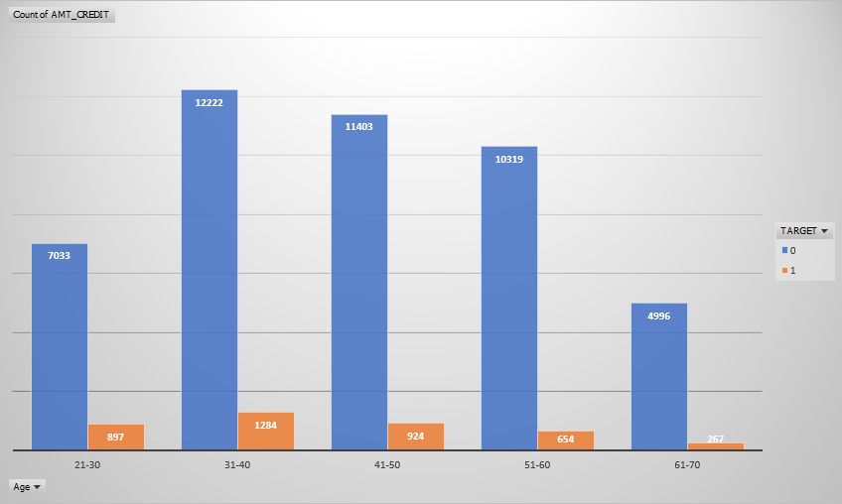
Young Adults (21-30): This group has the highest proportion of payment difficulties mainly due to limited financial experience, unstable income, and higher debt burdens like student loans.
Middle Age (31-50): Despite having the largest number of credit recipients, these groups show lower proportions of payment difficulties, indicating better financial stability.
Older Adults (51-70): Older age groups have the lowest payment difficulties, suggesting greater financial security and reliable repayment behavior

Slide 28
Task E: Segment the dataset based on different scenarios (e.g., clients with payment difficulties and all other cases) and identify the top correlations for each segmented data using Excel functions.
The dataset was segmented into 2 groups.
Group 1: Clients with payment difficulties (Target: 1).
Group 2: Clients without payment difficulties (Target: 0).
These groups were formed using Filter feature.
Next, the CORREL() function was used.

Slide 29
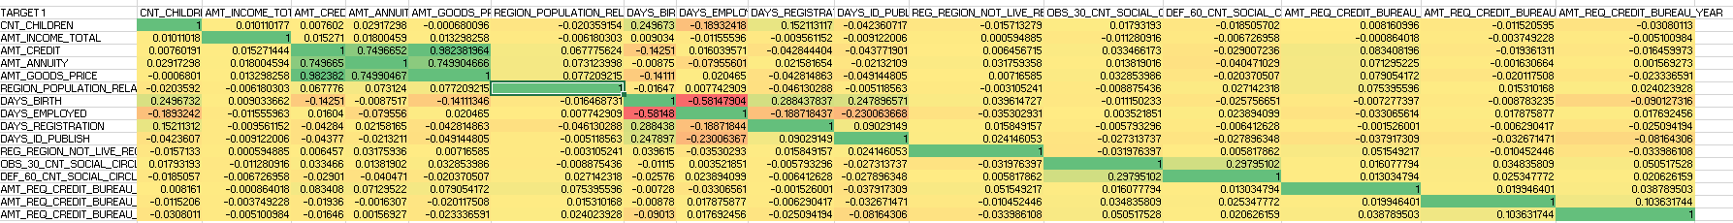
Some of the top correlations for Target 1 are:
AMT_GOODS_PRICE and AMT_CREDIT: 0.982381964
AMT_ANNUITY and AMT_CREDIT: 0.749665201
AMT_ANNUITY and AMT_GOODS_PRICE: 0.749904666

Slide 30
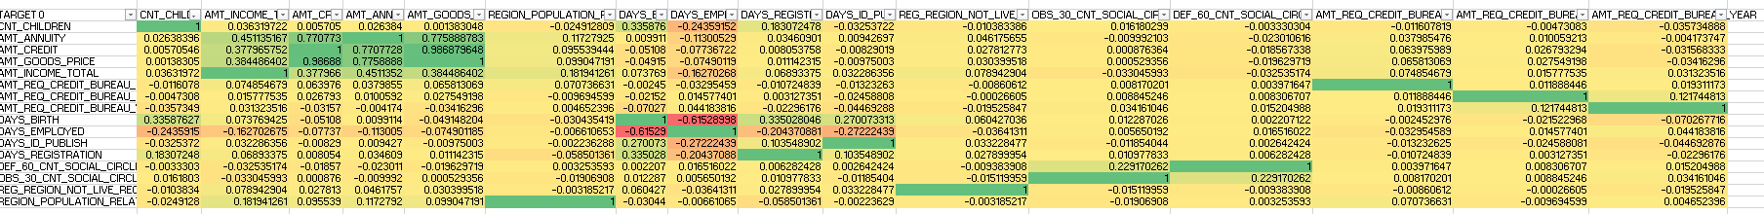
Some of the top correlations of Target 0 are:
AMT_GOODS_PRICE and AMT_CREDIT: 0.986879648
AMT_ANNUITY and AMT_CREDIT: 0.770772818
AMT_ANNUITY and AMT_GOODS_PRICE: 0.775888783

Slide 31
Results
Most clients are loan re-payers, and cash loans are the most common type of loan.
The bank lends more to females, but males are less likely to default on loans. Females have more defaulters but their ratio of defaulters and non-defaulters are better than males
Older and more experienced clients have a lower default risk and are more profitable for the bank.
Clients with higher education levels default less compared to those with lower education qualifications.
Unemployed clients have the highest default risk and often take larger loans, requiring caution in lending.
Clients with more children are less likely to take loans.
As age increases, the loan amounts taken are higher, but default rates are significantly lower, making older clients safer borrowers.
Avoiding excessively high loans above norms can reduce default rates and improve overall lending outcomes.

Slide 32
Conclusion
This project was a great learning experience, especially in handling large datasets and working with multiple data sources. It helped me improve my skills in dealing with missing values, outliers, and using Excel more efficiently. It also gave me a good idea of how to work with bank datasets and analyze big data, which has made me feel more confident about handling similar challenges in the future.

